Slide 1
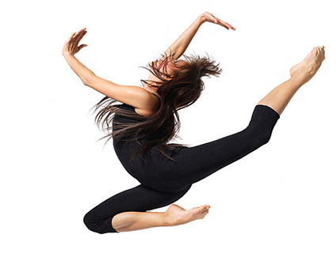
LESSON 7
YEAR 9 DANCE
DANCE SKILLS UNIT .

Slide 2

LONG TERM OBJECTIVES
explore and develop your dance skills and review your own practice
use your dance skills within rehearsal and performance.

Slide 3
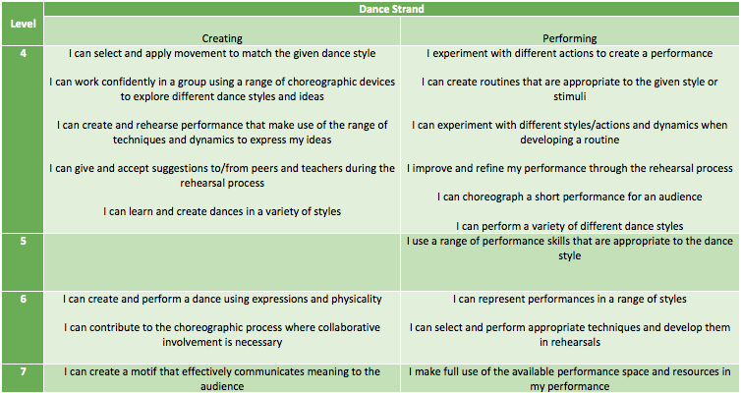
SUCCESS CRITERIA

Slide 4
ASSESSMENT LESSON !!!!!!!!

Slide 5
FOCUS FOR THE LESSON
MUSICALITY
MOVEMENT MEMORY
USE OF DYNAMICS
FLUIDITY OF MOVEMENT
PROJECTION

Slide 6

VIDEO RECORDING OF TECHNICAL WARM UP AND STREET DANCE ROUTINE.

Slide 7
PLENARY
HOW DO YOU FEEL YOUR ASSESSMENT WENT?
DID YOU TRY AS HARD AS YOU COULD?
WHAT DO YOU FEEL WENT WELL?
WHAT DO YOU FEEL YOU NEED TO IMPROVE ON?
HOW DO YOU FEEL YOUR ASSESSMENT WENT?
DID YOU TRY AS HARD AS YOU COULD?
WHAT DO YOU FEEL WENT WELL?
WHAT DO YOU FEEL YOU NEED TO IMPROVE ON?

